Slide 1

Phylogenetic analysis of Ebola virus secreted glycoprotein
Mahsa Askary Hemmat

Slide 2
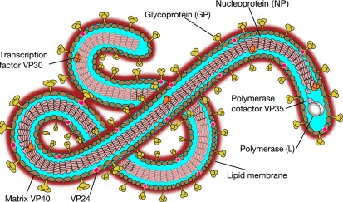
Ebola Virus Disease
Ebola virus disease (EVD) is a deadly disease with occasional outbreaks that occur mostly on the African continent.
Causes severe hemorrhagic fever in humans and nonhuman primates.
Its fatality rate can reach 90% and averages around 50%
Early detection is important, so infected individuals can be isolated and treated, which prevents the spread of the virus

Slide 3

Soluble glycoprotein (sGP) is a diagnostic marker of Ebola virus infection
EBOV glycoprotein gene produces three protein products: surface glycoprotein (GP1,2) and two secreted proteins (sGP and ssGP)
sGP can be detected in significant amounts in the sera of acutely infected patients within 3 days of exposure to the virus
Notes:
Page fades in, red pops up. Only this page

Slide 4
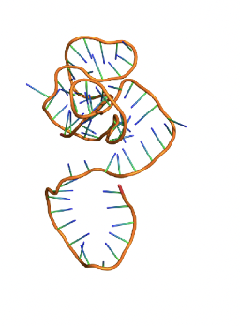
Aptamers as diagnostic tools
Aptamers are single-stranded oligonucleotides that bind to specific molecular targets, including proteins and small molecules with high affinity and specificity
The process of selecting an aptamer is called Systematic Evolution of Ligands by Exponential Enrichment (SELEX)
Because aptamers can be evolved to bind tightly and specifically to almost any protein, they have been regarded as potential diagnostic agents

Slide 5
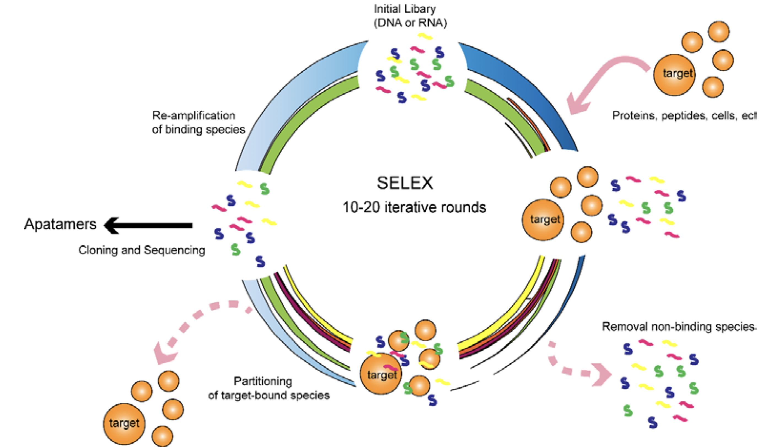
Systematic evolution of ligands by exponential enrichment (SELEX)

Slide 6
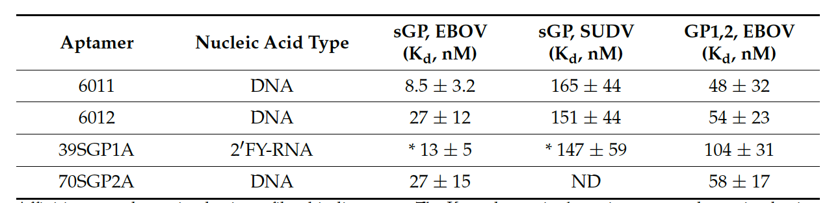
Aptamers have been selected to recognize Ebola virus sGP
Soma Banerjee

Slide 7
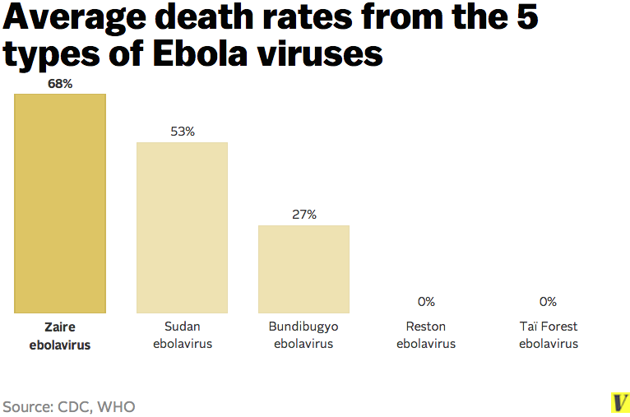
Different strains of Ebola virus
New Ebola virus: Bombali (2018)

Slide 8
Using sGP sequence of different strains of EBOV to build a phylogenetic tree
Methods::
Downloaded sGP sequences of different strains of EBOV from NCBI (6 taxa, 364 amino acids)
Blast search > Marburg virus GP sequence (681 amino acids)
Aligned Sequences using clustalW
BEAST 2, Blossum62 substitution model, Yule model, 1000000 generations

Slide 9
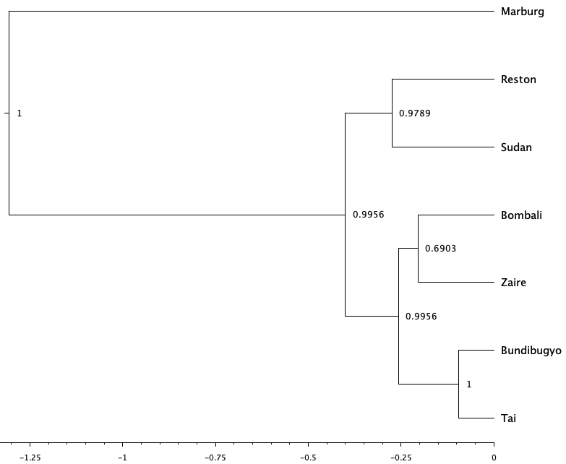
Bayesian phylogenetic tree of EBOV sGP

Slide 10

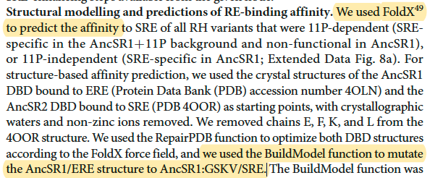
Prediction of binding energies of sGP to the 70SGP2A aptamer

Slide 11
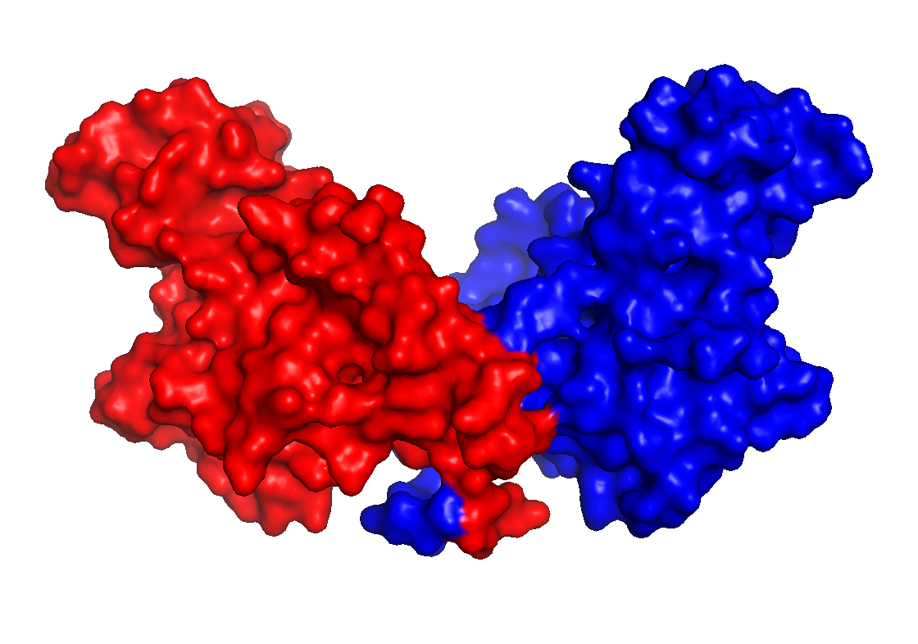
sGP structure
Downloaded from PDB database. (PDB ID: 5KEM)
Removed the antibodies
sGP

Slide 12

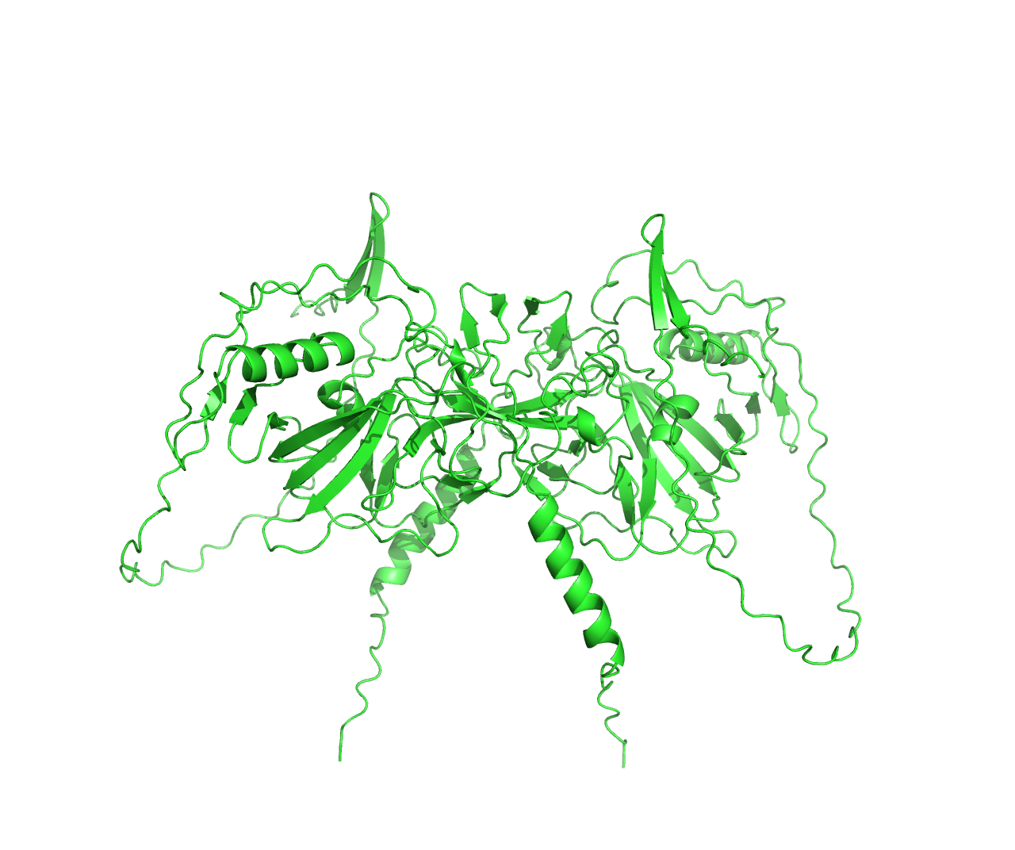
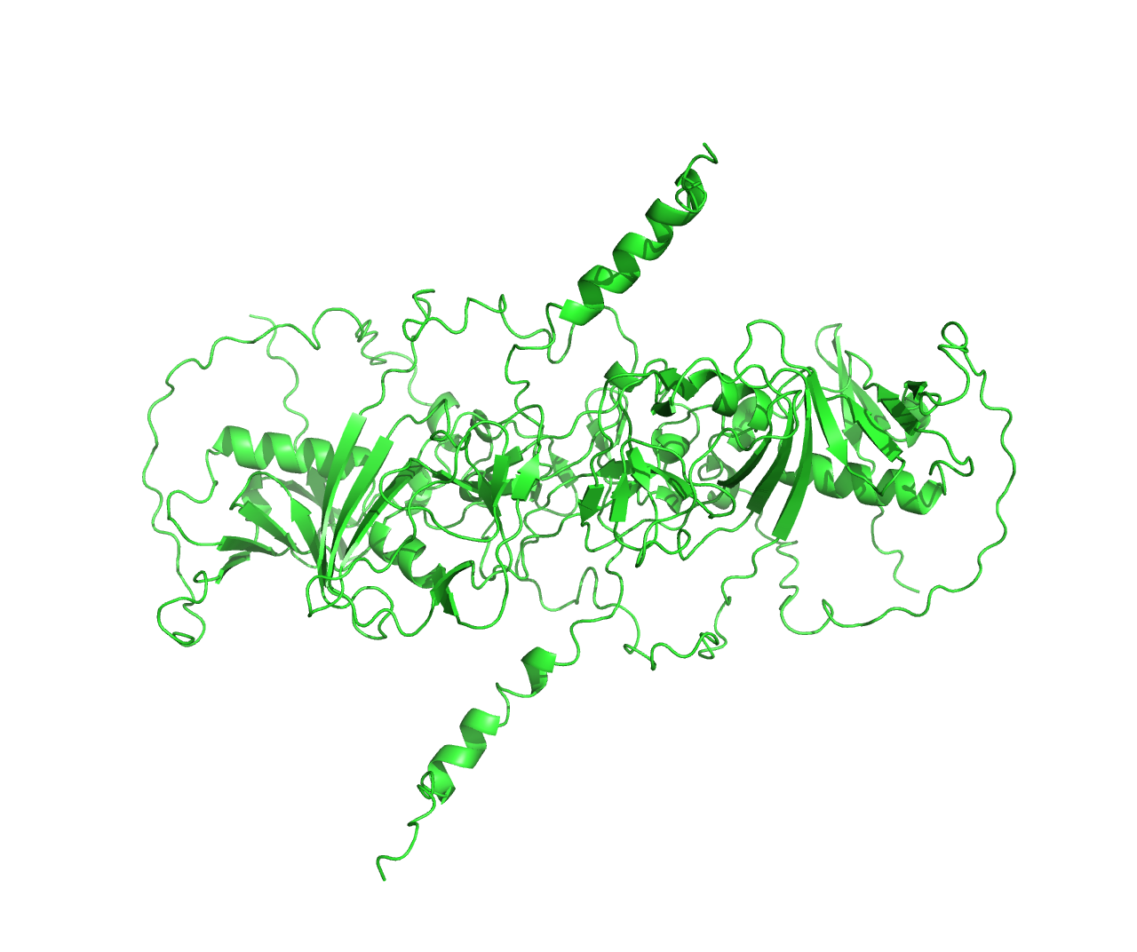
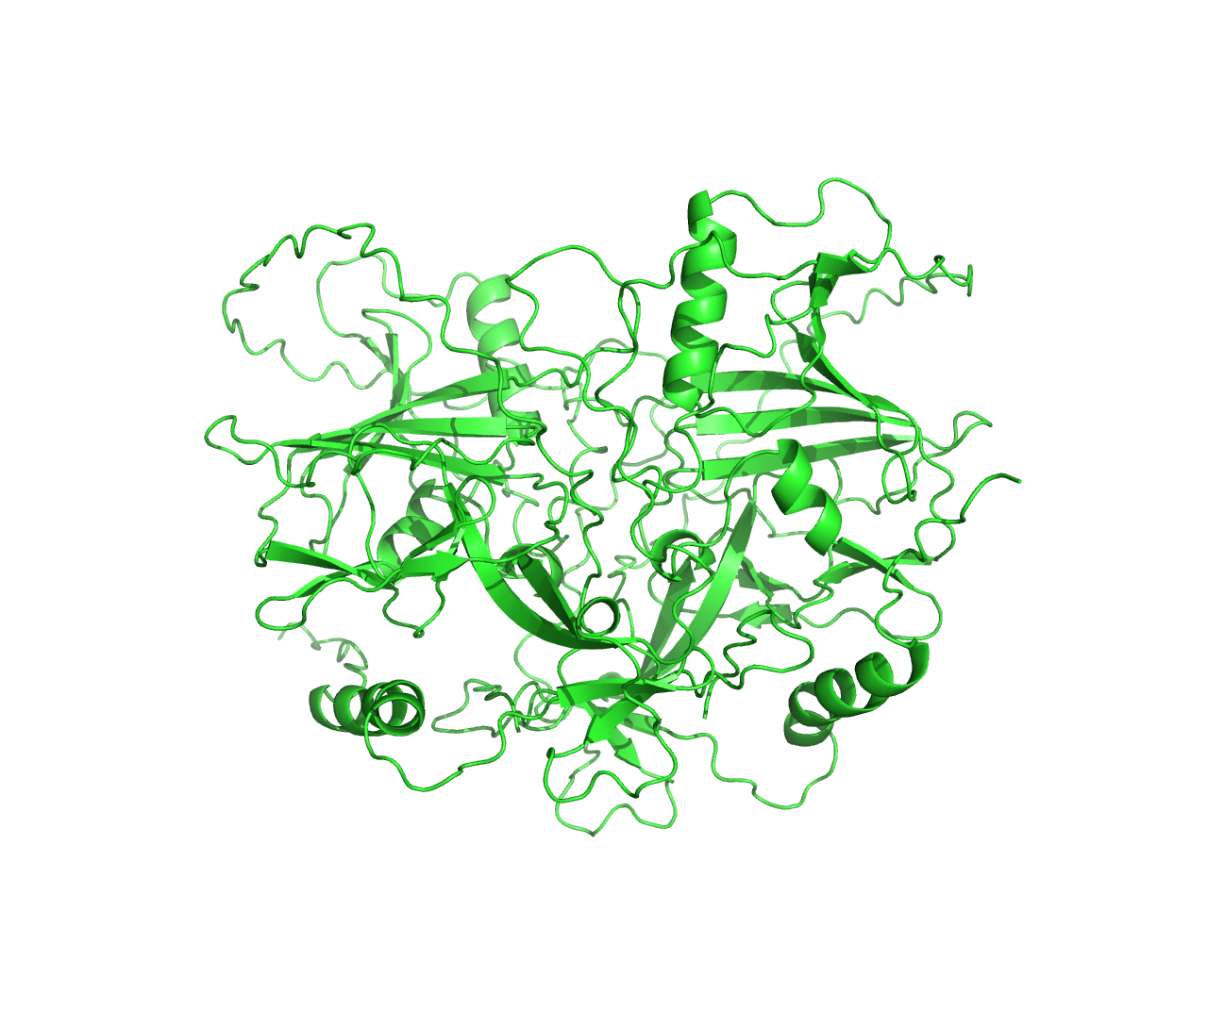

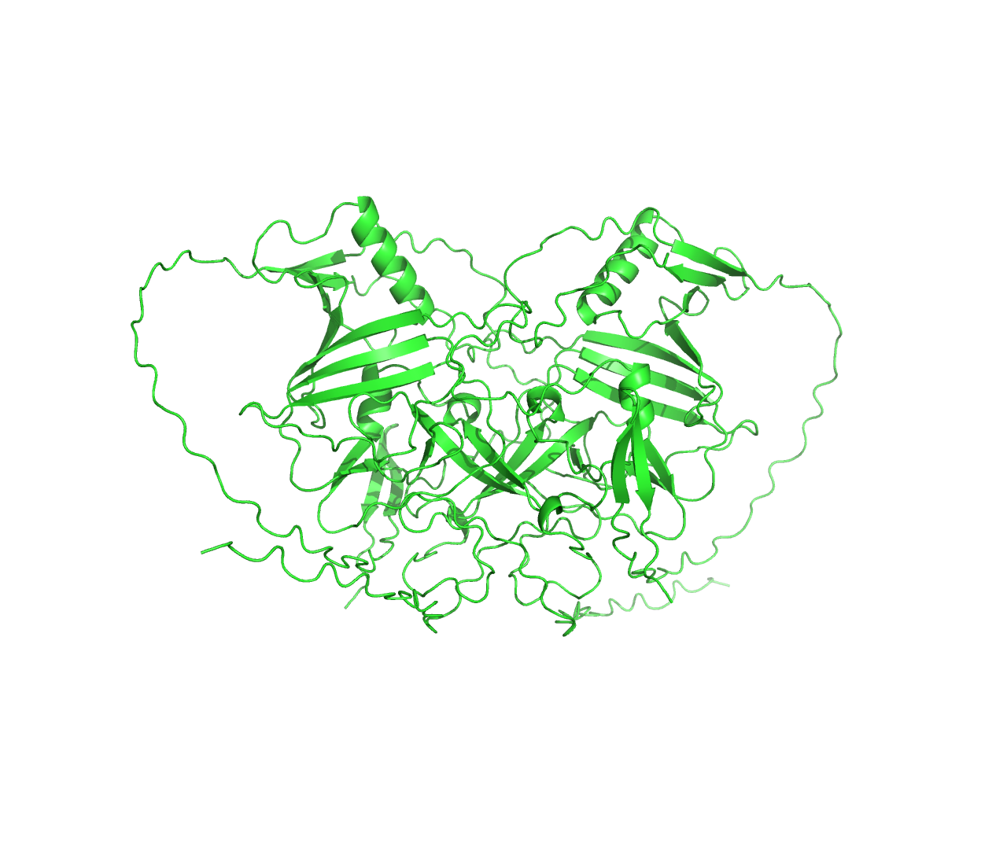
Prediction EBOV sGP and Marburg GP structure using Alphafold 2
A
B
C
D
E
F
A. Sudan EBOV sGP, B. Tai Forest, C. Bundibugyo, D. Bombali, E. Reston, F. Marburg GP

Slide 13
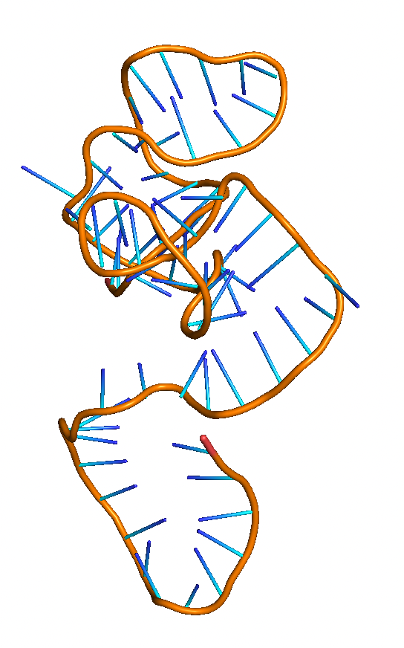
Molecular modeling: Aptamer secondary and tertiary structure
70SGP2A
UNAfold- 23 ℃
3dRNA/DNA web server

Slide 14
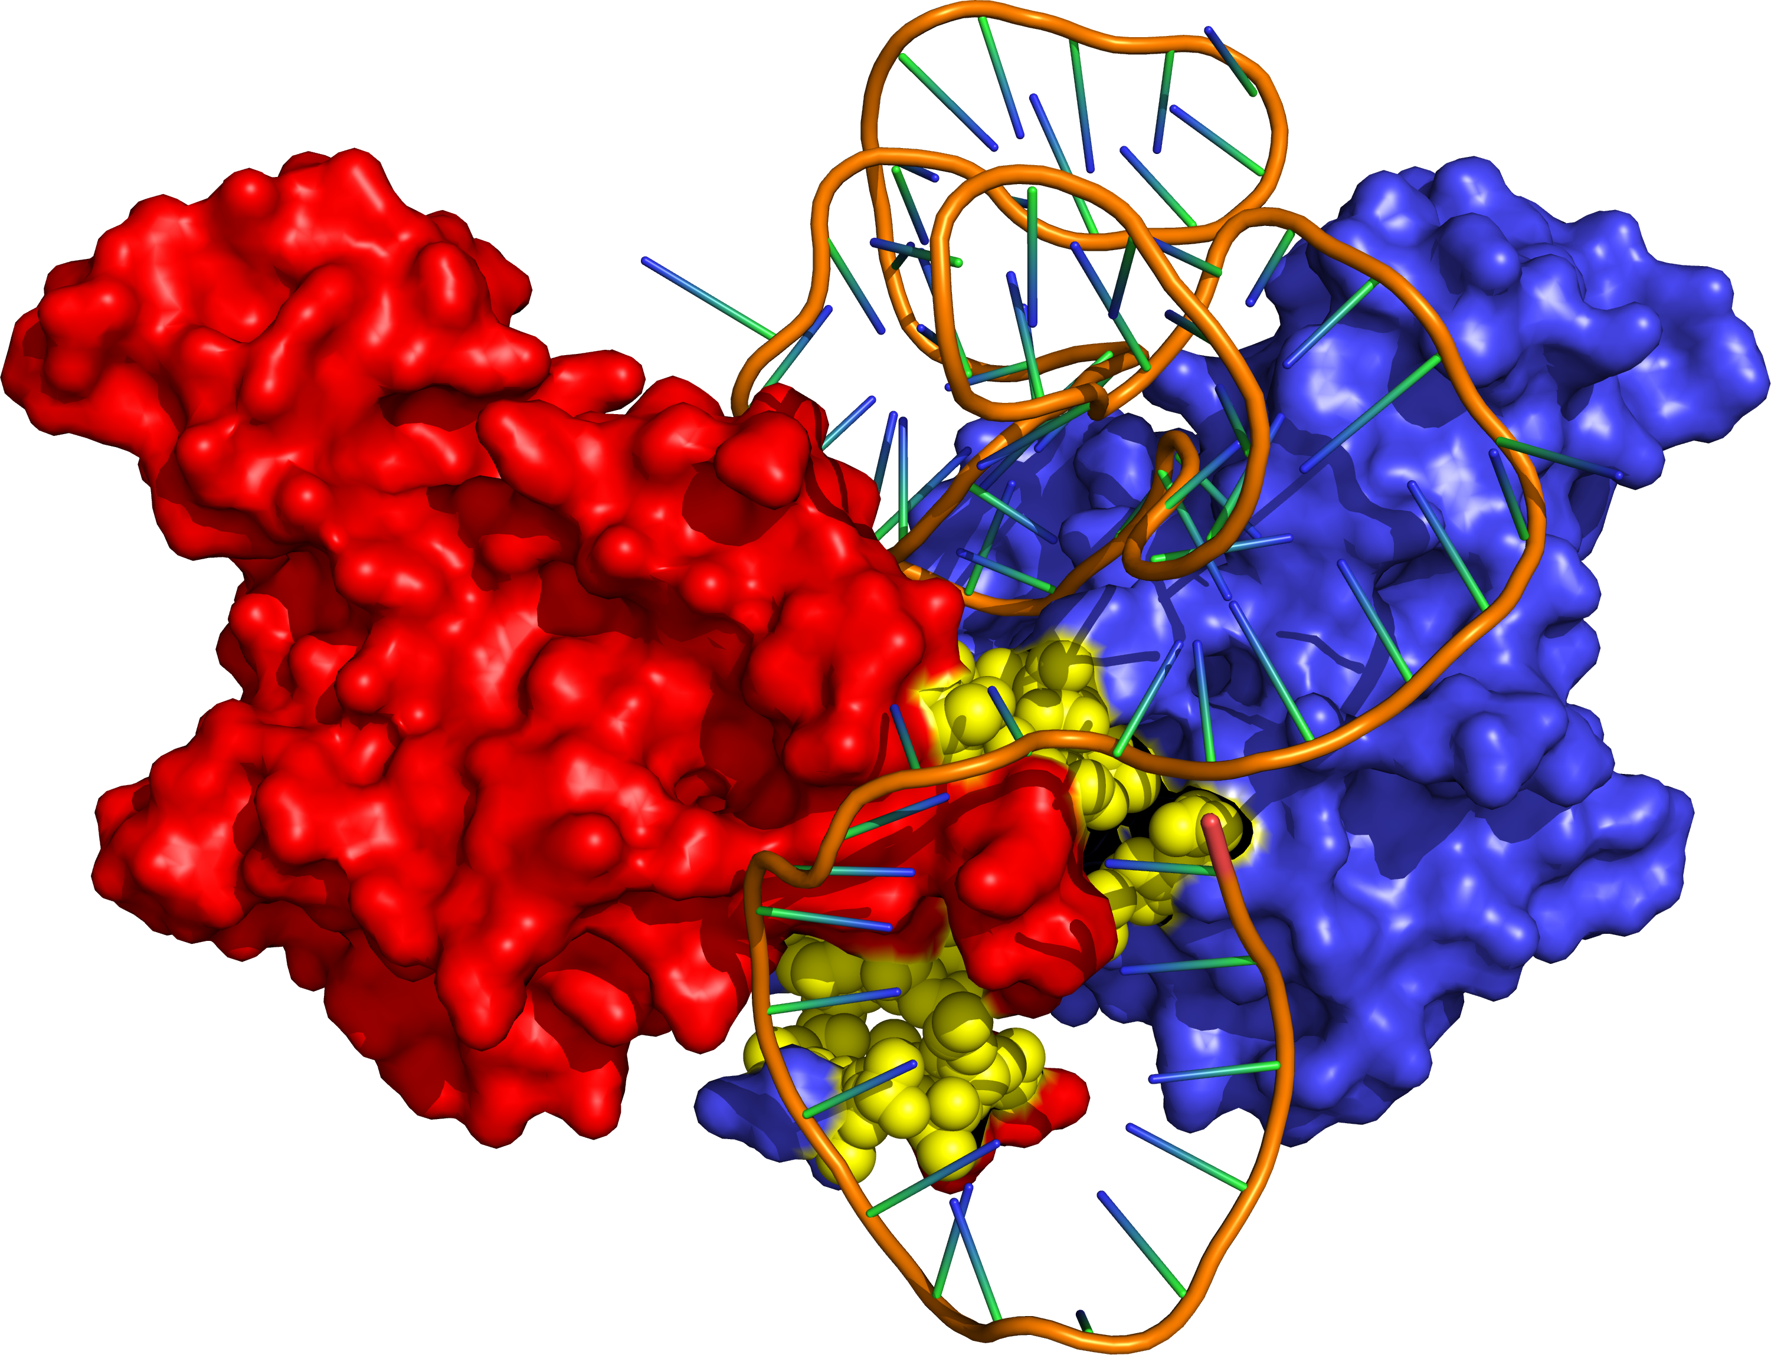
Molecular modeling-Docking
Zaire sGP docked to EBOV aptamer

Slide 15
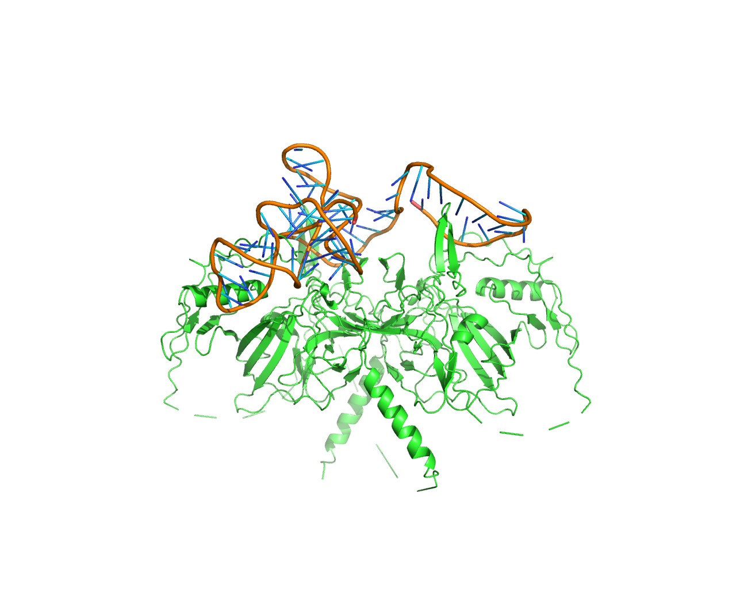
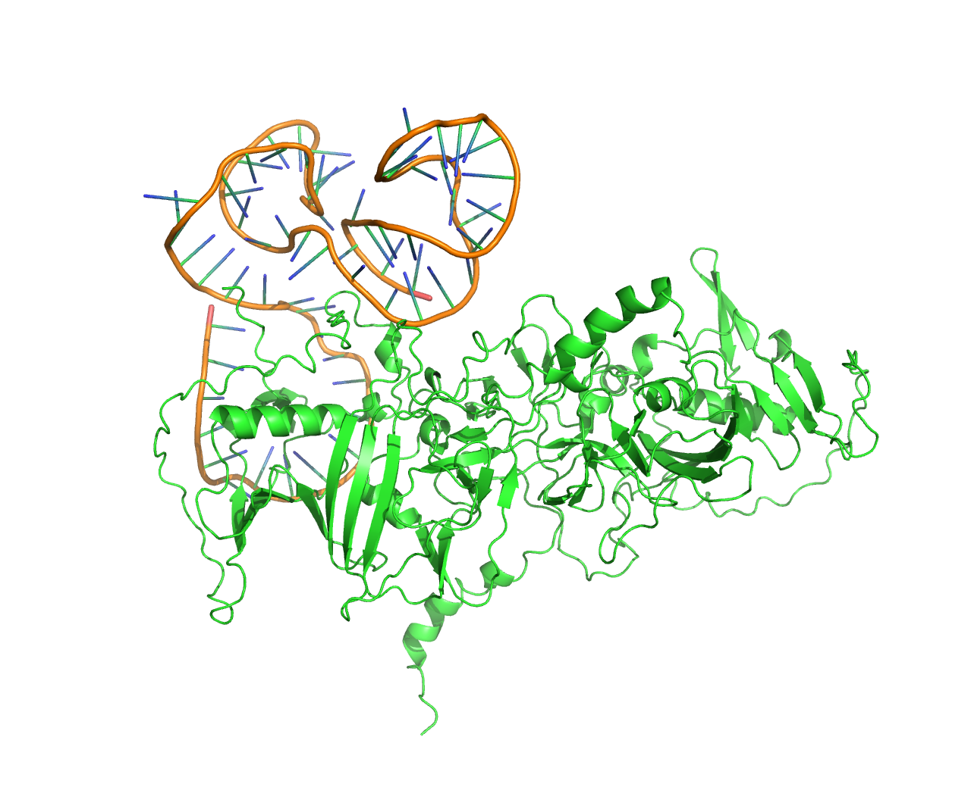
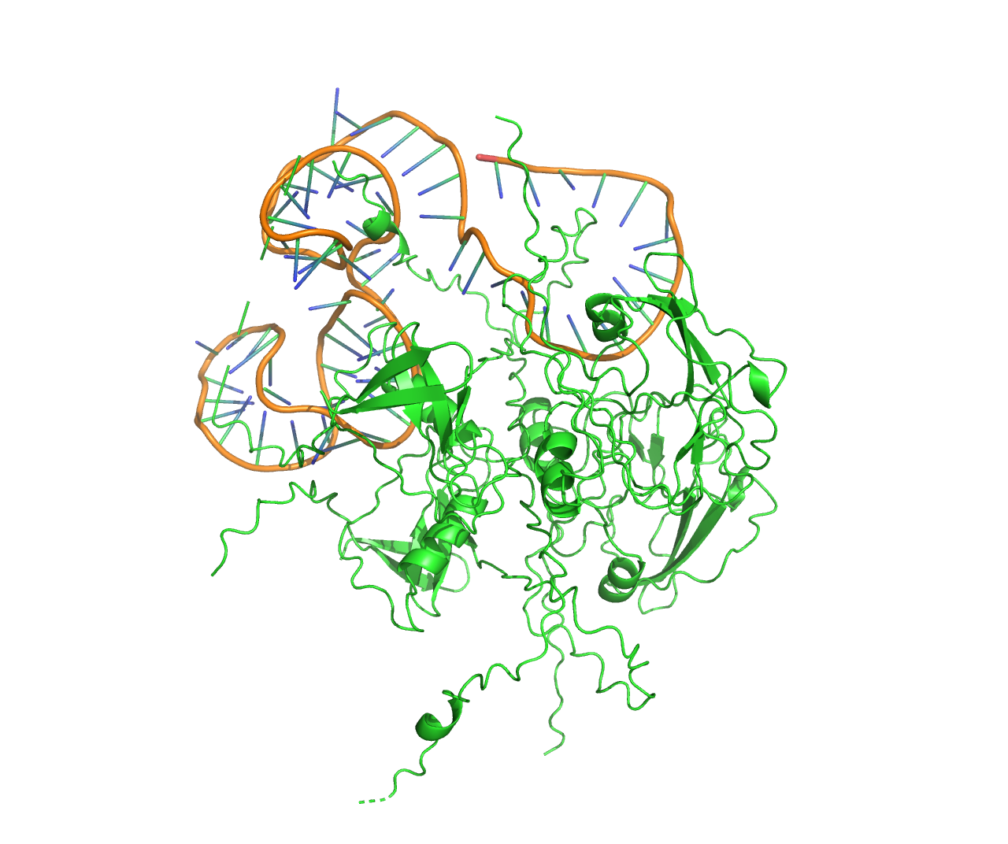
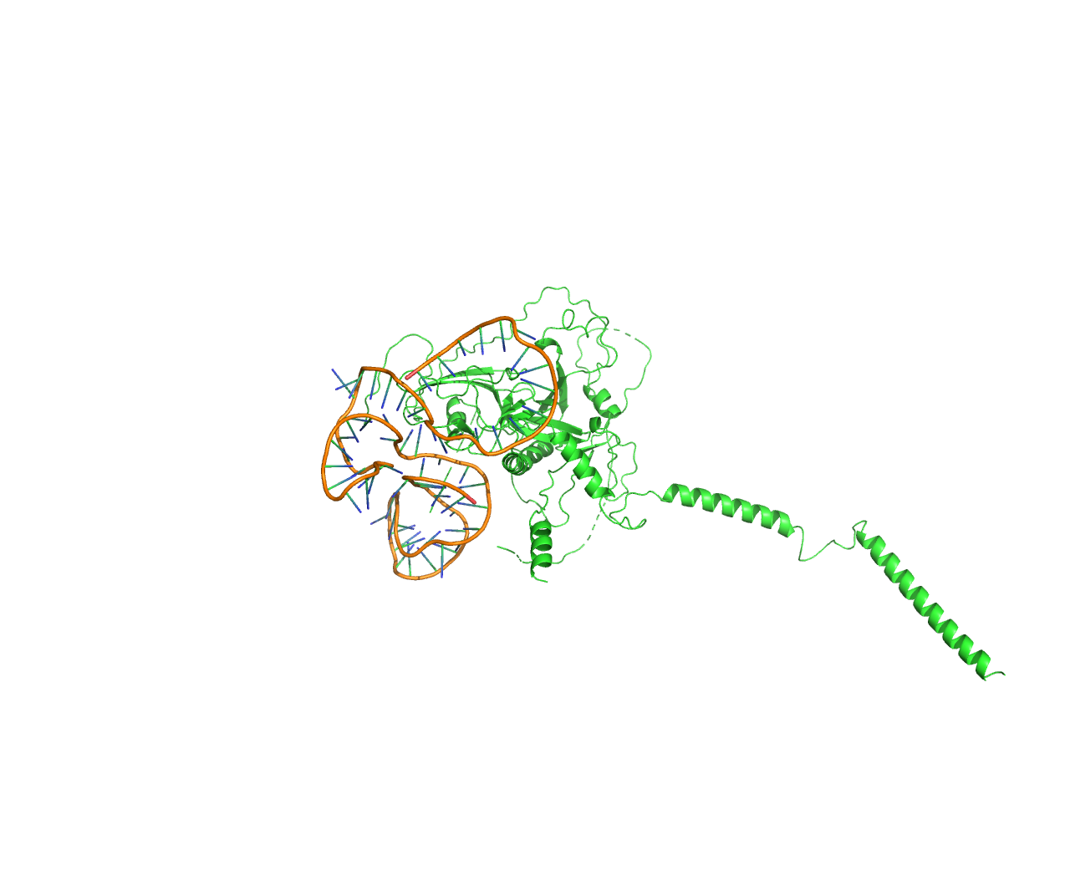
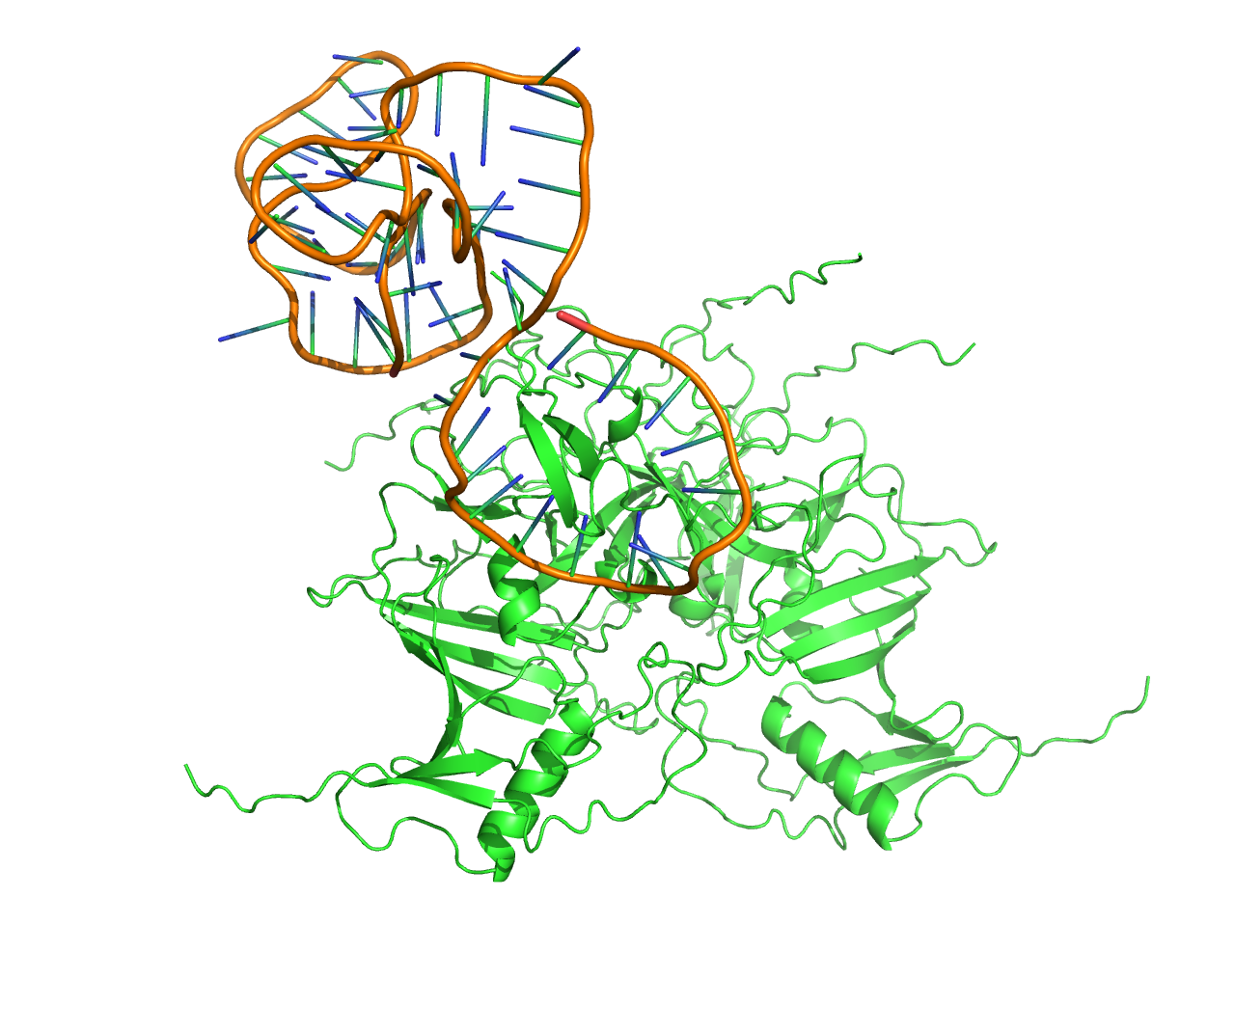
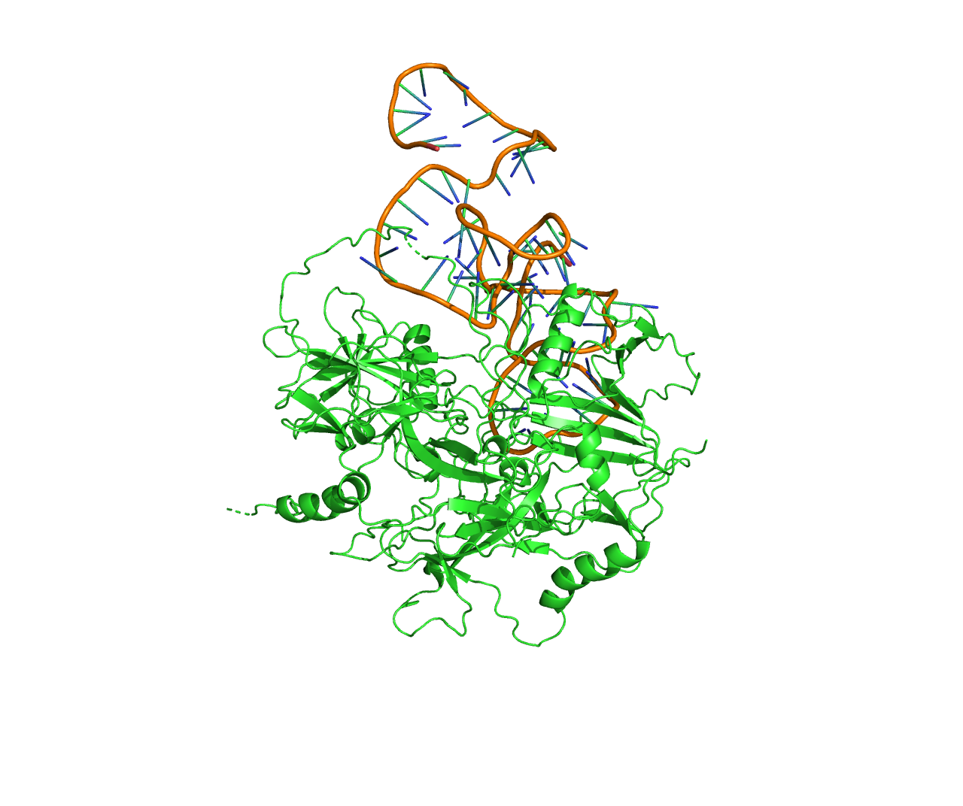
Molecular docking of EBOV sGP and Marburg GP to 70SGP2A aptamer
A
B
C
D
E
F
A. Sudan EBOV sGP, B. Tai Forest, C. Bundibugyo, D. Bombali, E. Reston, F. Marburg GP

Slide 16
Predicting binding energy using FoldX
Virus name and protein | Energy of binding (kcal/mol)
Bombali EBOV sGP | 70.07
Bundibugyo EBOV sGP | 90.6
Reston EOV sGP | 43.31
Sudan EBOV sGP | 24.25
Tai Forest EBOV sGP | 56.1
Zaire EBOV sGP | 31.19
Marburg virus GP | 53.75

Slide 17
EBOV sGP phylogenetic tree with the predicted binding energies
53.75 kcal/mol
43.31 kcal/mol
24.25 kcal/mol
70.07 kcal/mol
31.19 kcal/mol
90.06 kcal/mol
56.01 kcal/mol

Slide 18
Summary
Generated Bayesian Phylogenetic tree for EBOV sGP
Predicted binding energy of EBOV sGP to 70SGP2A aptamer
Compared the binding energy values with the evolutionary relationship of different strains of EBOV virus

Slide 19
Thank you

